Slide 1
Probabilistic model:-
Probabilistic Models are one of the most important segments in Machine Learning, which is based on the application of statistical codes to data analysis. This dates back to one of the first approaches of machine learning and continues to be widely used today. Unobserved variables are seen as stochastic in probabilistic models, and interdependence between variables is recorded in a joint probability distribution. It provides a foundation for embracing learning for what it is. The probabilistic framework outlines the approach for representing and deploying model reservations. In scientific data analysis, predictions play a dominating role. Their contribution is also critical in machine learning, cognitive computing, automation, and artificial intelligence.

Slide 2
Probability Basics
Prior, conditional and joint probability for random variables
Prior probability:
Conditional probability:
Joint probability:
Relationship:
Independence:
Bayesian Rule
Discriminative
Generative

Slide 3
Probabilistic Classification Principle
Establishing a probabilistic model for classification
Discriminative model
To train a discriminative classifier regardless its probabilistic or non-probabilistic nature, all training examples of different classes must be jointly used to build up a single discriminative classifier.
Output L probabilities for L class labels in a probabilistic classifier while a single label is achieved by a non-probabilistic classifier .
Discriminative
Probabilistic Classifier

Slide 4
Probabilistic Classification Principle
Establishing a probabilistic model for classification (cont.)
Generative model (must be probabilistic)
L probabilistic models have to be trained independently
Each is trained on only the examples of the same label
Output L probabilities for a given input with L models
“Generative” means that such a model produces data subject to the distribution via sampling.
Generative
Probabilistic Model
for Class 1
Generative
Probabilistic Model
for Class L

Slide 5
Probabilistic Classification Principle
Maximum A Posterior (MAP) classification rule
For an input x, find the largest one from L probabilities output by a discriminative probabilistic classifier
Assign x to label c* if is the largest.
Generative classification with the MAP rule
Apply Bayesian rule to convert them into posterior probabilities
Then apply the MAP rule to assign a label
Common factor for all L probabilities

Slide 6
Principle of probabilistic model?
Probabilistic modeling is a statistical approach that uses the effect of random occurrences or actions to forecast the possibility of future results. It is a quantitative modeling method that projects several possible outcomes that might even go beyond what has happened recently. Probabilistic modeling considers new situations and a wide range of uncertainty while not underestimating dangers. The three primary building blocks of probabilistic modeling are adequate probability distributions, correct use of input information for these distribution functions, and proper accounting for the linkages and interactions between variables. The downside of the probabilistic modeling technique is that it needs meticulous development, a process that depends on several assumptions and large input data

Slide 7
Importance of probabilistic model:-
One of the most significant advantages of the probabilistic modeling technique is that it provides a comprehensive understanding of the uncertainty associated with predictions. Using this method, we can quickly determine how confident any mobile learning model is and how accurate its prediction is

Slide 8
Examples:-
Generalized Linear model:-
One of the better applications of probabilistic modeling is generalized linear models. This vastly generalizes linear regression using exponential families. The expected return of a specified unknown factor (the response variable, a random variable) is predicted by ordinary linear regression as a linear combination of a collection of observed value

Slide 9
Weather and Traffic:-
Weather and traffic are two everyday phenomena that are both unpredictable and appear to have a link with one another. You are all aware that if the weather is cold and snow is falling, traffic will be quite difficult and you will be detained for an extended period of time. We could even go so far as to predict a substantial association between snowy weather and higher traffic mishaps. Based on available data, we can develop a basic mathematical model of traffic accidents as a function of snowy weather to aid in the analysis of our hypothesis. All of these models are based on probabilistic modeling. It is one of the most effective approaches for assessing weather and traffic relationships

Slide 10
Straight Line Modeling:-
A straight-line probabilistic model is sometimes known as a linear regression model or a best-fit straight line. It's a best-fit line since it tries to reduce the size of all the different error components. A linear regression model may be computed using any basic spreadsheet or statistical software application. However, the basic computation is just dependent on a few variables. This is another implementation that is based on probabilistic modeling

Slide 11
Conclusion:-
Probabilistic Models are a great way to understand the trends that can be derived from the data and create predictions for the future. As one of the first topics that is taught in Machine Learning, the importance of probabilistic models is understated. These models provide a foundation for the machine learning models to understand the prevalent trends and their behavio

Slide 12
Naïve Bayes algorithm:-
the Naïve Bayes algorithm is comprised of two words Naïve and Bayes, Which can be described as:
Naïve: It is called Naïve because it assumes that the occurrence of a certain feature is independent of the occurrence of other features. Such as if the fruit is identified on the bases of color, shape, and taste, then red, spherical, and sweet fruit is recognized as an apple. Hence each feature individually contributes to identify that it is an apple without depending on each other.
Bayes: It is called Bayes because it depends on the principle of Bayes' Theorem

Slide 13
Bayesian rule:-
Bayes' Theorem:
Bayes' theorem is also known as Bayes' Rule or Bayes' law, which is used to determine the probability of a hypothesis with prior knowledge. It depends on the conditional probability. The formula for Bayes' theorem is given as:
Naïve Bayes Classifier Algorithm Where,
P(A|B) is Posterior probability: Probability of hypothesis A on the observed event B.P(B|A) is Likelihood probability: Probability of the evidence given that the probability of a hypothesis is true.
P(A) is Prior Probability: Probability of hypothesis before observing the evidence. P(B) is Marginal Probability: Probability of Evidence.

Slide 14
Naïve Bayes
Bayes classification
Difficulty: learning the joint probability is infeasible!
Naïve Bayes classification
Assume all input features are class conditionally independent!
Apply the MAP classification rule: assign to c* if
Applying the independence assumption
Notes:
For a class, the previous generative model can be decomposed by n generative models of a single input.

Slide 15
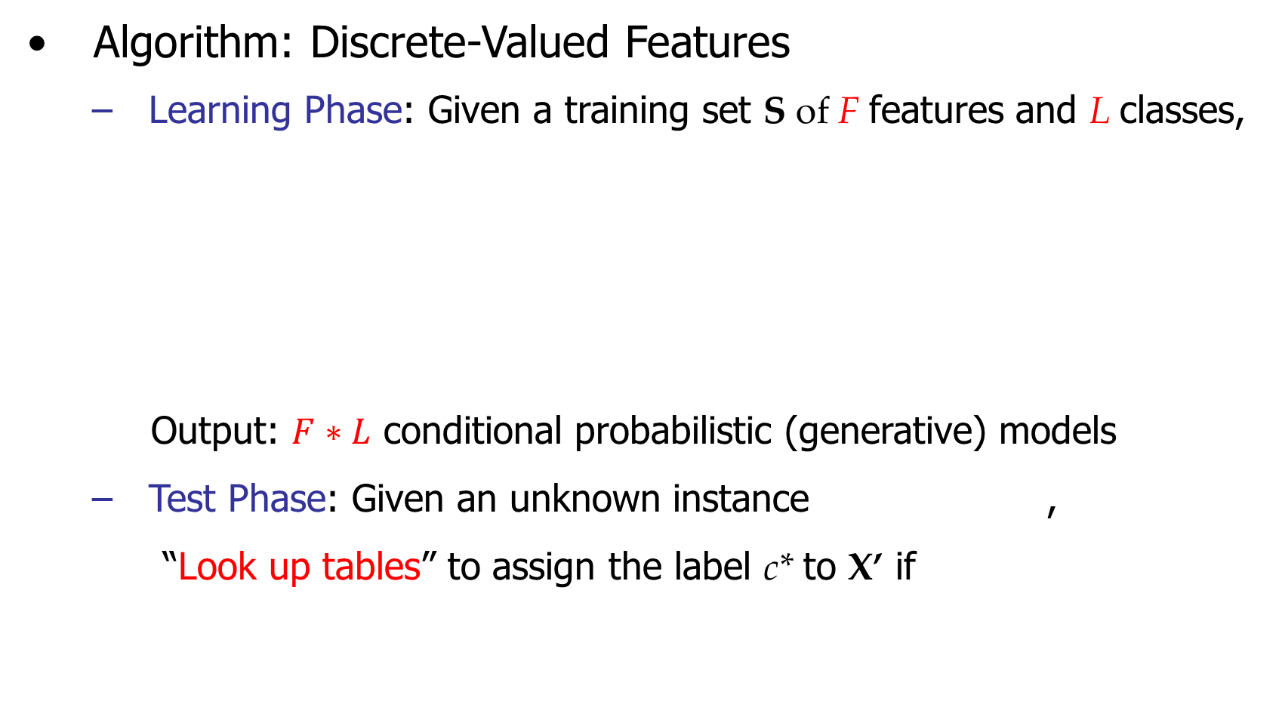
Naïve Bayes

Slide 16
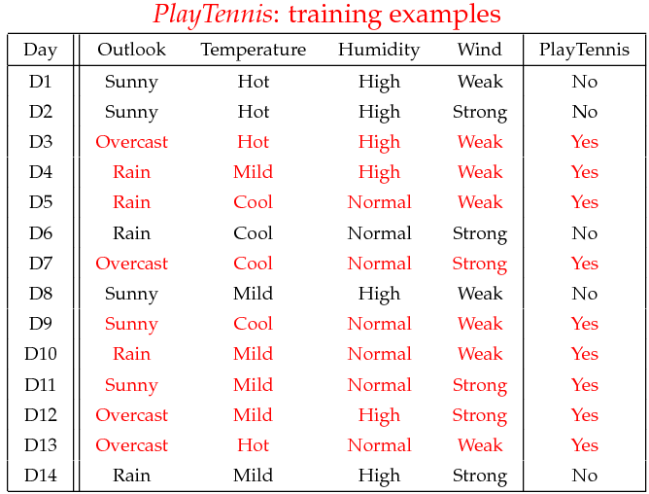
Example
Example: Play Tennis

Slide 17
Example
Learning Phase
Outlook | Play=Yes | Play=No
Sunny | 2/9 | 3/5
Overcast | 4/9 | 0/5
Rain | 3/9 | 2/5
Temperature | Play=Yes | Play=No
Hot | 2/9 | 2/5
Mild | 4/9 | 2/5
Cool | 3/9 | 1/5
Humidity | Play=Yes | Play=No
High | 3/9 | 4/5
Normal | 6/9 | 1/5
Wind | Play=Yes | Play=No
Strong | 3/9 | 3/5
Weak | 6/9 | 2/5
P(Play=Yes) = 9/14
P(Play=No) = 5/14

Slide 18
Example
Test Phase
Given a new instance, predict its label
x’=(Outlook=Sunny, Temperature=Cool, Humidity=High, Wind=Strong)
Look up tables achieved in the learning phrase
Decision making with the MAP rule
P(Outlook=Sunny|Play=Yes) = 2/9
P(Temperature=Cool|Play=Yes) = 3/9
P(Huminity=High|Play=Yes) = 3/9
P(Wind=Strong|Play=Yes) = 3/9
P(Play=Yes) = 9/14
P(Outlook=Sunny|Play=No) = 3/5
P(Temperature=Cool|Play==No) = 1/5
P(Huminity=High|Play=No) = 4/5
P(Wind=Strong|Play=No) = 3/5
P(Play=No) = 5/14
P(Yes|x’) ≈ [P(Sunny|Yes)P(Cool|Yes)P(High|Yes)P(Strong|Yes)]P(Play=Yes) = 0.0053
P(No|x’) ≈ [P(Sunny|No) P(Cool|No)P(High|No)P(Strong|No)]P(Play=No) = 0.0206
Given the fact P(Yes|x’) < P(No|x’), we label x’ to be “No”.

Slide 19


Bayes’ Rule
Exactly the process we just used
The most important formula in probabilistic machine learning
$P\left(A | B\right)=\frac{P(B|A)×P\left(A\right)}{P\left(B\right)}$
(Super Easy) Derivation:
$$P\left( A∧B\right)=P\left(A | B\right)×P\left(B\right)$$
$$P\left(B∧A\right) =P\left(B | A\right)×P\left(A\right)$$
Just set equal...
and solve...
$$P\left(A | B\right)×P\left(B\right)=P\left(B | A\right)×P(A)$$
Bayes, Thomas (1763) An essay towards solving a problem in the doctrine of chances. Philosophical Transactions of the Royal Society of London, 53:370-418
Notes:
P(A \mid B) &= \frac{P(B \mid A) \times P(A)}{P(B)}
P(A \land B) &= P(A \mid B) \times P(B)\\
P(B \land A) &= P(B \mid A) \times P(A)

Slide 20
Naïve Bayes
Algorithm: Continuous-valued Features
Numberless values taken by a continuous-valued feature
Conditional probability often modeled with the normal distribution
Learning Phase:
Output: normal distributions and
Test Phase: Given an unknown instance
Instead of looking-up tables, calculate conditional probabilities with all the normal distributions achieved in the learning phrase
Apply the MAP rule to assign a label (the same as done for the discrete case)

Slide 21
Naïve Bayes
Example: Continuous-valued Features
Temperature is naturally of continuous value.
Yes: 25.2, 19.3, 18.5, 21.7, 20.1, 24.3, 22.8, 23.1, 19.8
No: 27.3, 30.1, 17.4, 29.5, 15.1
Estimate mean and variance for each class
Learning Phase: output two Gaussian models for P(temp|C)

Slide 22
Zero conditional probability
If no example contains the feature value
In this circumstance, we face a zero conditional probability problem during test
For a remedy, class conditional probabilities re-estimated with
(m-estimate)

Slide 23
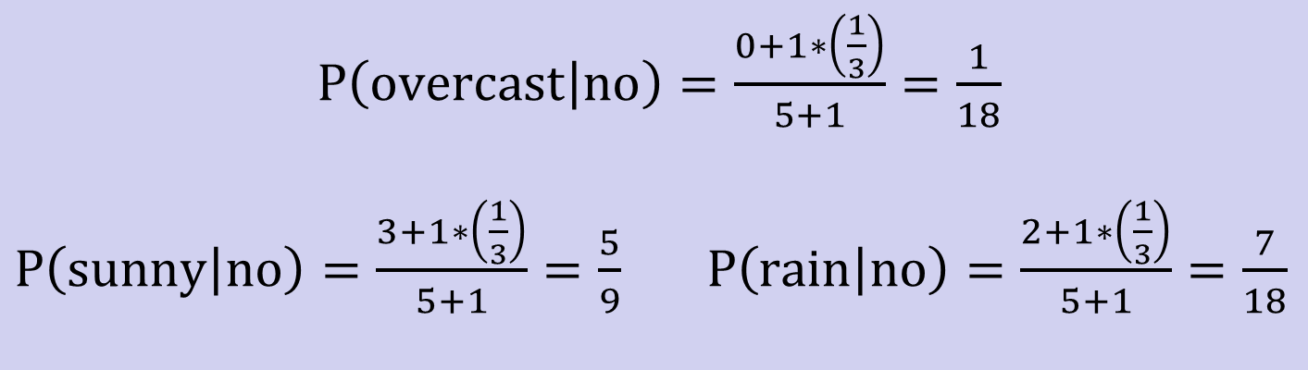
Zero conditional probability
Example: P(outlook=overcast|no)=0 in the play-tennis dataset
Adding m “virtual” examples (m: up to 1% of #training example)
In this dataset, # of training examples for the “no” class is 5.
We can only add m=1 “virtual” example in our m-esitmate remedy.
The “outlook” feature can takes only 3 values. So p=1/3.
Re-estimate P(outlook|no) with the m-estimate

Slide 24
Naïve Bayes Classification:- Things We’d Like to Do
Spam Classification
Given an email, predict whether it is spam or not
Medical Diagnosis
Given a list of symptoms, predict whether a patient has disease X or not
Weather
Based on temperature, humidity, etc… predict if it will rain tomorrow

Slide 25
Bayesian Classification
Problem statement:
Given features X₁,X₂,…,X_{n}
Predict a label Y

Slide 26
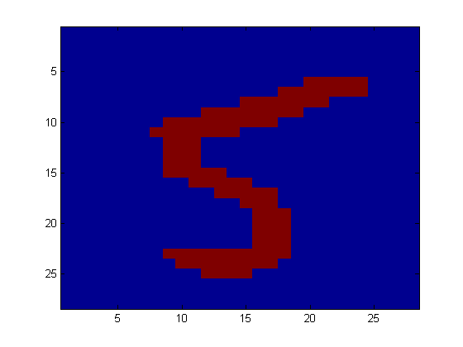
Another Application
Digit Recognition
X₁,…,X_{n} ∈ {0,1} (Black vs. White pixels)
Y ∈ {5,6} (predict whether a digit is a 5 or a 6)
Classifier
5

Slide 27

The Bayes Classifier
A good strategy is to predict:
(for example: what is the probability that the image represents a 5 given its pixels?)
So … How do we compute that?

Slide 28
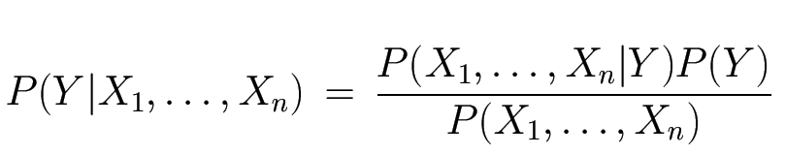
The Bayes Classifier
Use Bayes Rule!
Why did this help? Well, we think that we might be able to specify how features are “generated” by the class label
Likelihood
Prior
Normalization Constant

Slide 29
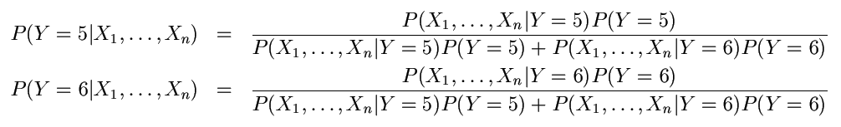
The Bayes Classifier
Let’s expand this for our digit recognition task:
To classify, we’ll simply compute these two probabilities and predict based on which one is greater

Slide 30
Model Parameters
For the Bayes classifier, we need to “learn” two functions, the likelihood and the prior
How many parameters are required to specify the prior for our digit recognition example?
How many parameters are required to specify the likelihood?
(Supposing that each image is 30x30 pixels)
?

Slide 31
Model Parameters
The problem with explicitly modeling P(X₁,…,X_{n}|Y) is that there are usually way too many parameters:
We’ll run out of space
We’ll run out of time
And we’ll need tons of training data (which is usually not available)

Slide 32
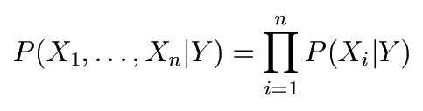
The Naïve Bayes Model
The Naïve Bayes Assumption: Assume that all features are independent given the class label Y
Equationally speaking:
(We will discuss the validity of this assumption later)

Slide 33
Why is this useful?
# of parameters for modeling P(X₁,…,X_{n}|Y):
2(2^{n}-1)
# of parameters for modeling P(X₁|Y),…,P(X_{n}|Y)
2n

Slide 34
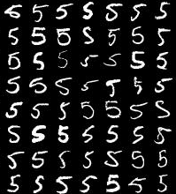
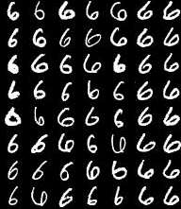
Naïve Bayes Training
Now that we’ve decided to use a Naïve Bayes classifier, we need to train it with some data:
MNIST Training Data

Slide 35
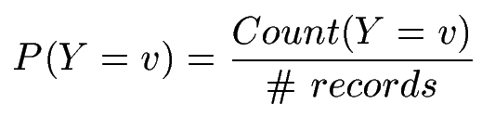

Naïve Bayes Training
Training in Naïve Bayes is easy:
Estimate P(Y=v) as the fraction of records with Y=v
Estimate P(X_{i}=u|Y=v) as the fraction of records with Y=v for which X_{i}=u
(This corresponds to Maximum Likelihood estimation of model parameters)

Slide 36
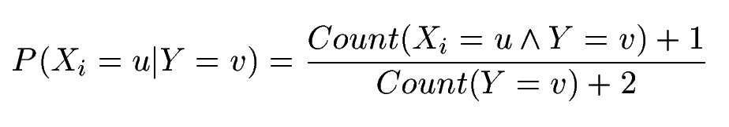
Naïve Bayes Training
In practice, some of these counts can be zero
Fix this by adding “virtual” counts:
(This is like putting a prior on parameters and doing MAP estimation instead of MLE)
This is called Smoothing

Slide 37
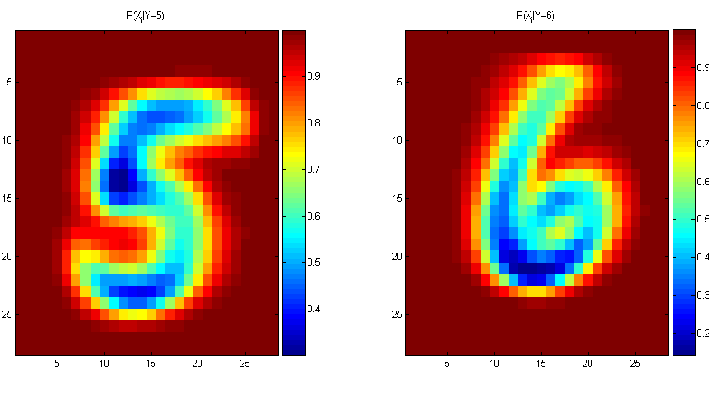
Naïve Bayes Training
For binary digits, training amounts to averaging all of the training fives together and all of the training sixes together.

Slide 38
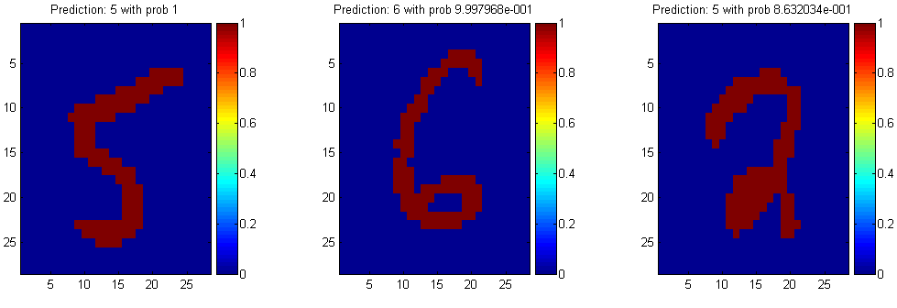
Naïve Bayes Classification

Slide 39
Another Example of the Naïve Bayes Classifier
The weather data, with counts and probabilities
outlook |  |  | temperature |  |  | humidity |  |  | windy |  |  | play
 | yes | no |  | yes | no |  | yes | no |  | yes | no | yes | no
sunny | 2 | 3 | hot | 2 | 2 | high | 3 | 4 | false | 6 | 2 | 9 | 5
overcast | 4 | 0 | mild | 4 | 2 | normal | 6 | 1 | true | 3 | 3
rainy | 3 | 2 | cool | 3 | 1
sunny | 2/9 | 3/5 | hot | 2/9 | 2/5 | high | 3/9 | 4/5 | false | 6/9 | 2/5 | 9/14 | 5/14
overcast | 4/9 | 0/5 | mild | 4/9 | 2/5 | normal | 6/9 | 1/5 | true | 3/9 | 3/5
rainy | 3/9 | 2/5 | cool | 3/9 | 1/5
A new day
outlook | temperature | humidity | windy | play
sunny | cool | high | true | ?

Slide 40
Likelihood of yes
Likelihood of no
Therefore, the prediction is No

Slide 41
Summary
Probabilistic Classification Principle
Discriminative vs. Generative models: learning P(c|x) vs. P(x|c)
Generative models for classification: MAP and Bayesian rule
Naïve Bayes: the conditional independence assumption
Training and test are very efficient.
Two different data types lead to two different learning algorithms.
Working well sometimes for data violating the assumption!
Naïve Bayes: a popular generative model for classification
Performance competitive to most of state-of-the-art classifiers even in presence of violating independence assumption
Many successful applications, e.g., spam mail filtering
A good candidate of a base learner in ensemble learning
Apart from classification, naïve Bayes can do more…

